Slide 1
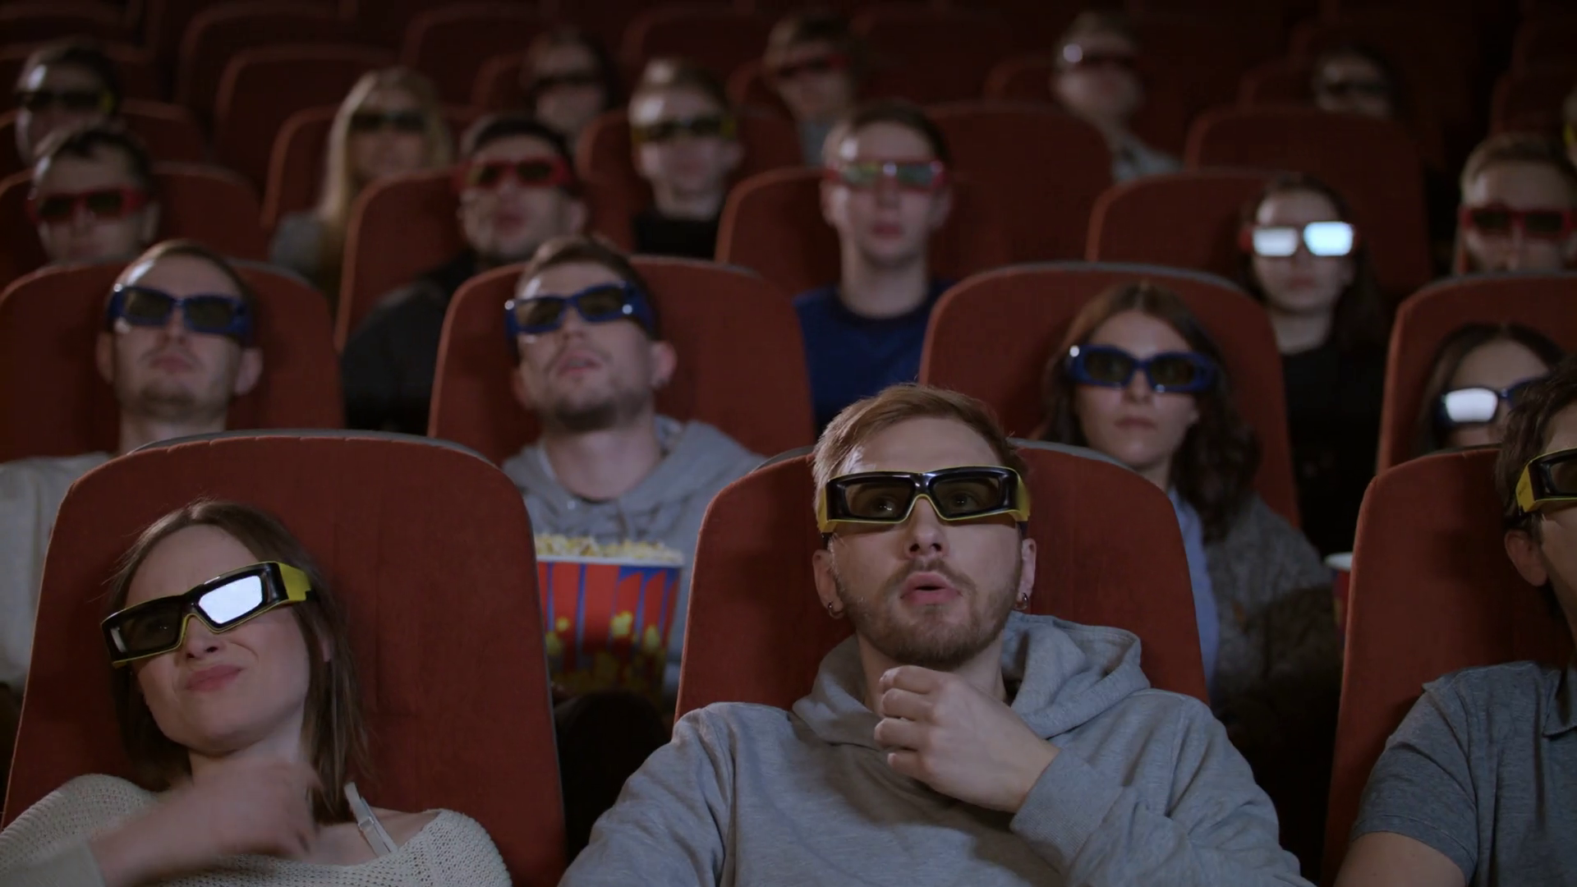

DATA SCIENCE END-TO-END PROJECT
P330 (Group-1)
Project Entitled:
“CONTENT BASED MOVIE RECOMMENDATION SYSTEM”
Group Members:
Mr. Saurav Kishore Kawale
Mr. Ravi Shankar BJ
Mr. Akash PatilKulkarni
Mr. Manoj M
Ms. Mansi Sanjay Mahanubhav
Ms. Sana Sultana

Slide 2

CONTENTS
Business Objective
Project Flowchart
Scraping the website
Exploratory Data Analysis
Vectorization & Algorithm
Recommendation Function
Deployment & Working
Obstacles
Key Takeaway's

Slide 3


OBJECTIVE
Scraping Movies from IMDb website and creating a Data set.
The dataset should include a variety of attributes such as movie name, release year, rating, metascore, gross income, votes, runtime, genre, certificate, description, directors, and stars.
To perform analysis for deeper insights.
Build a content based recommendation system.

Slide 4

Project Flow
WEB SCRAPING
Exploratory Data Analysis
Recommendation System
ETL
(Extract- Transform -Load)
Vectorization
Deployment
Collecting and Storing data
ML Algorithm

Slide 5
SCRAPING
Web scraping for movies involves extracting information about movies from websites.
Used BeautifulSoup for parsing HTML documents.
To Scrape multiple pages we put the URL in a for loop.
Striped around 7586 movies details with Movie Id , Movie Name, Runtime, Rating, Votes, Metascore, Genre, Certification, Description, Stars, Directors.
Stored the stripped data in a temporary list and kept it appending till the for loop is over. Link to the first page: - https://www.imdb.com/list/ls503325184/?st_dt=&mode=detail&page=1&sort=moviemeter,asc

Slide 6
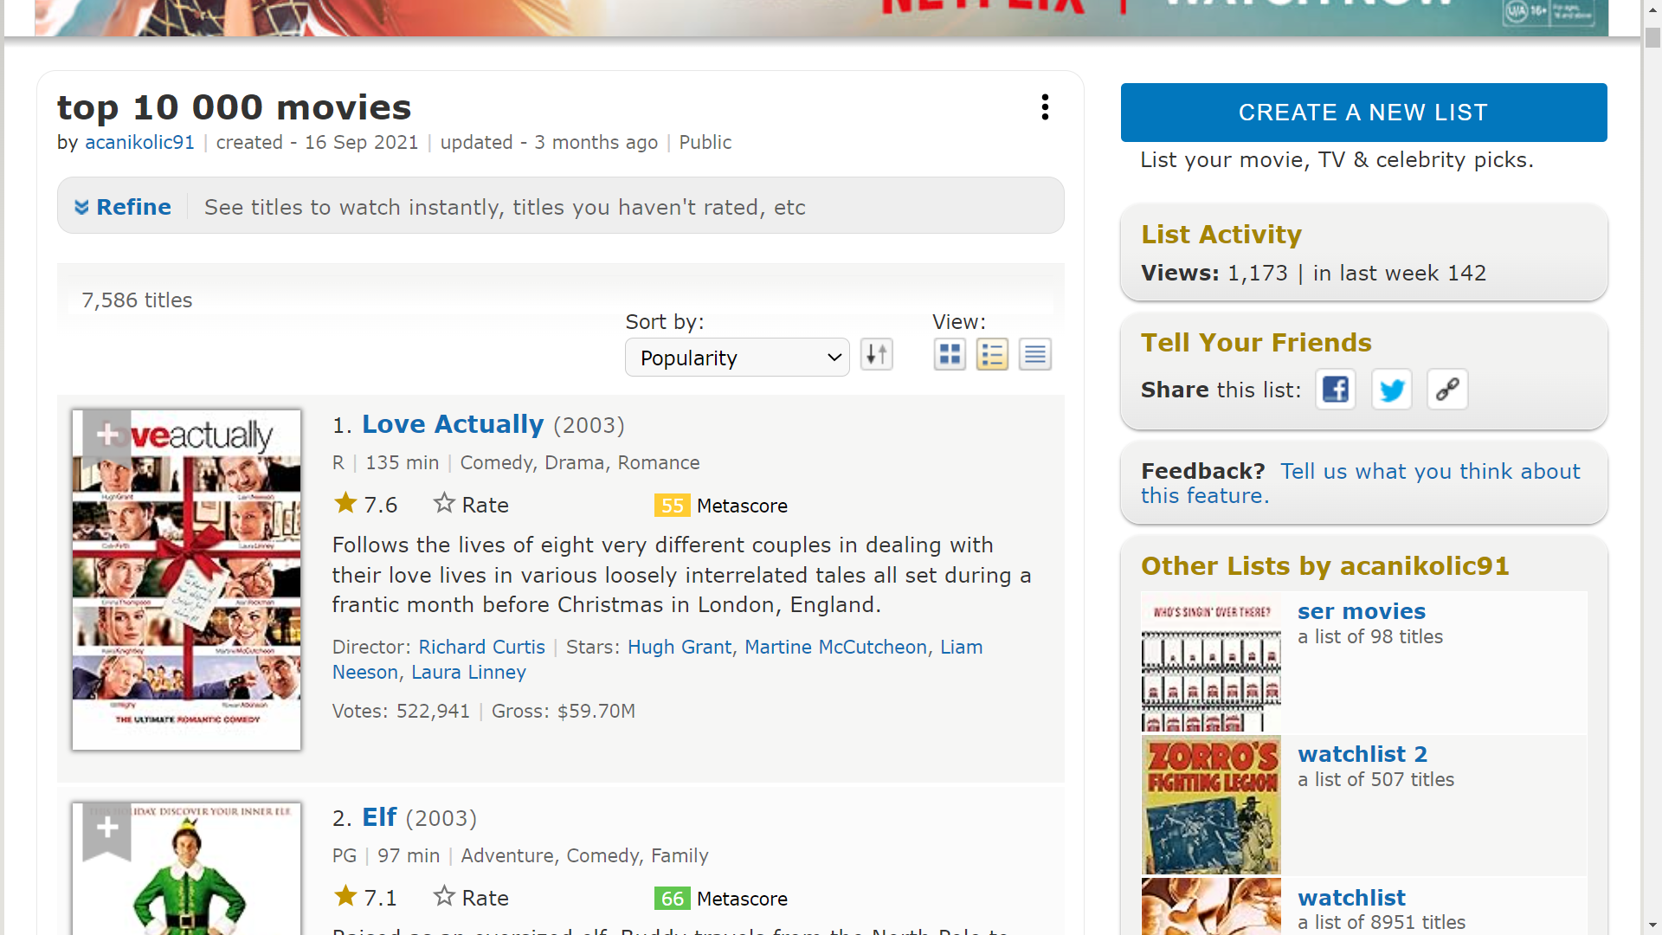
SCRAPING

Slide 7
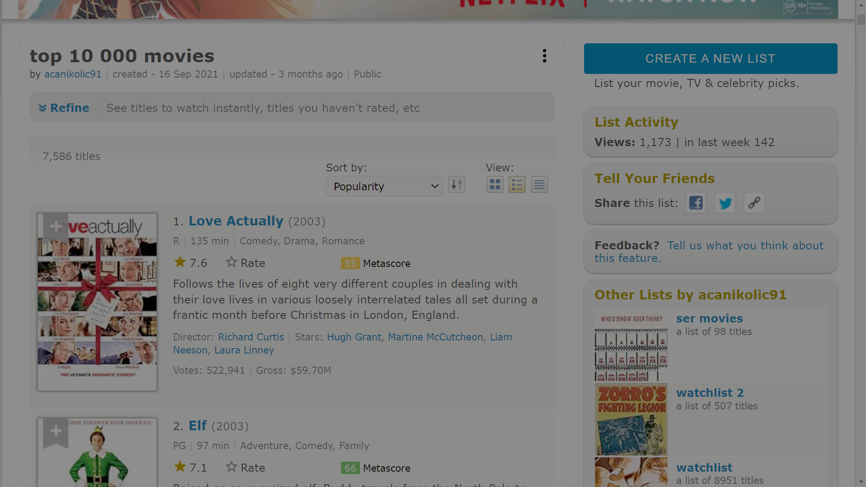

Slide 14
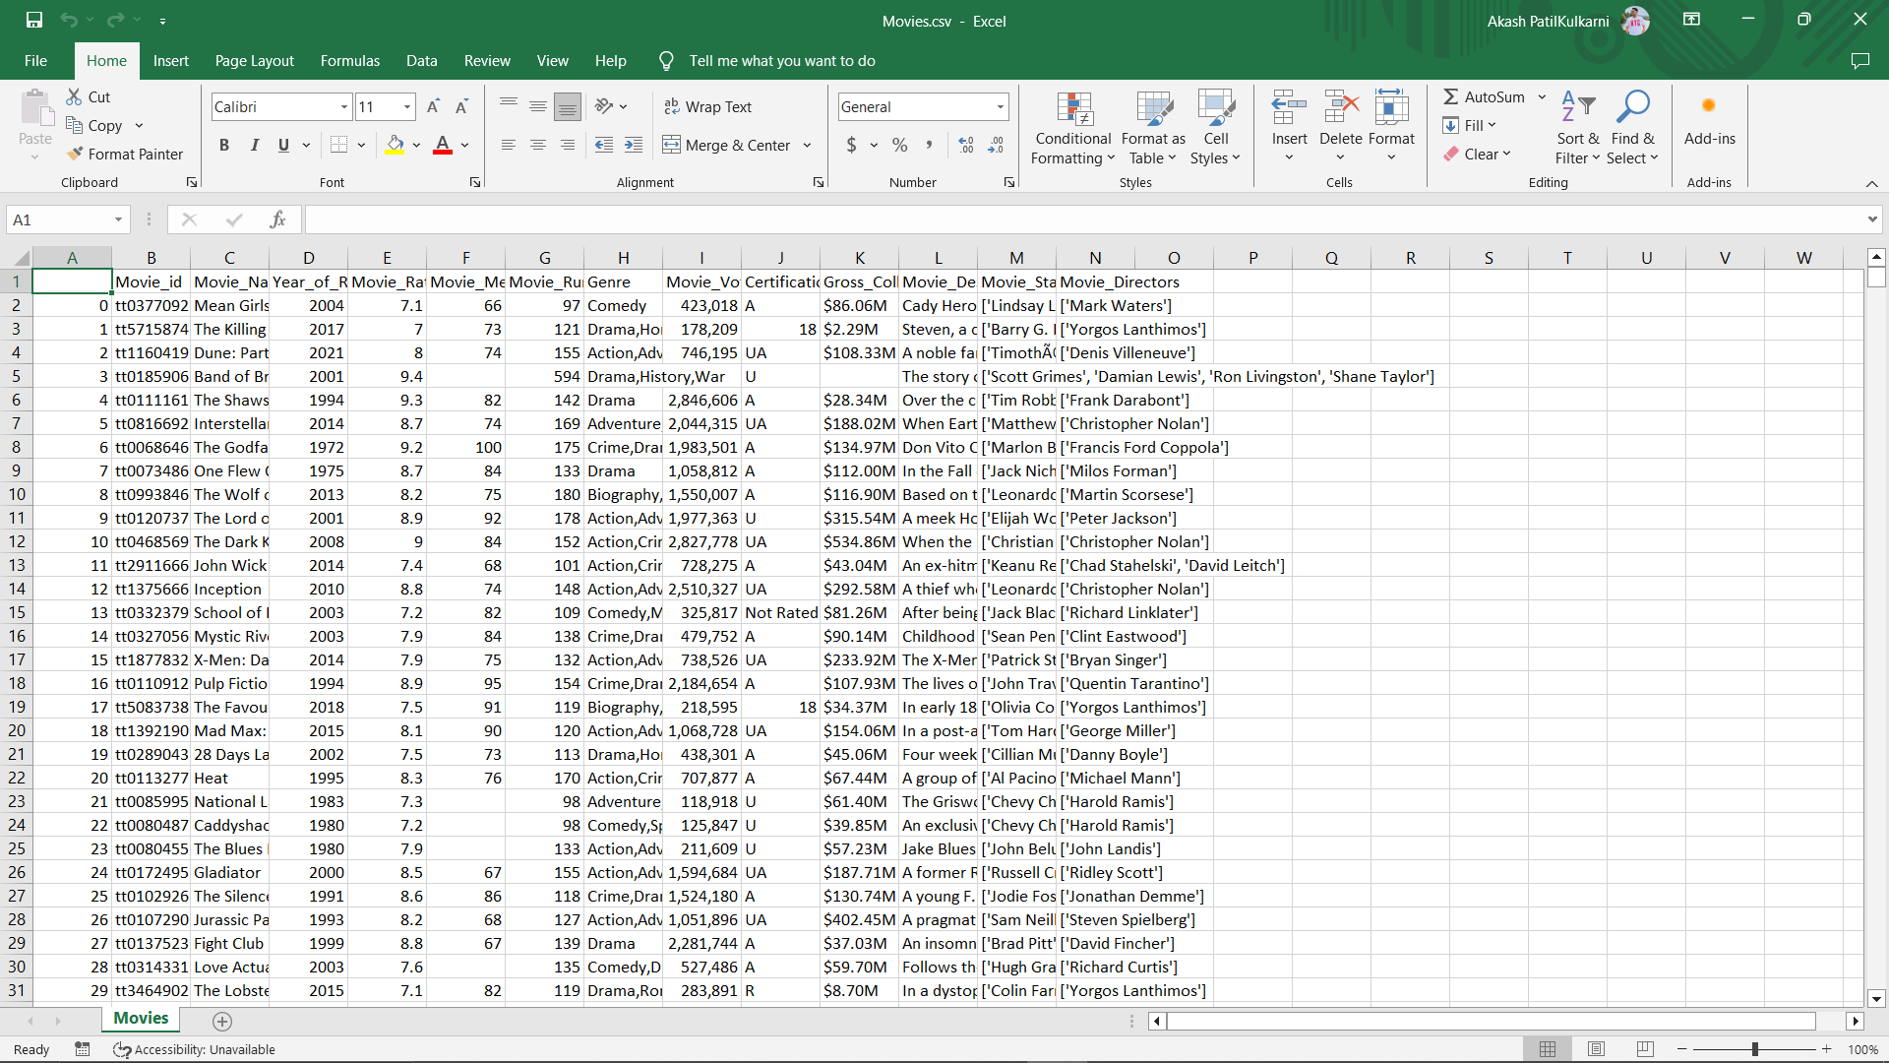
Data Set

Slide 15
EDA Process
The EDA part consists of understanding the data, finding missing values, Correlations, presence of outliners in the data.
Movie Name: The name of the movie.
Release Year: The year the movie was released.
Genre: The genre(s) of the movie.
Director: The director(s) of the movie.
Stars: The main actors in the movie.
Runtime: The duration of the movie.
Rating: The movie's rating.
Metascore: The Metascore rating.
Votes: The number of votes the movie received.
Gross Income: The gross income of the movie.
Description: A brief description of the movie.

Slide 16
EDA Process
We check for null values and data type Errors.
Top movie Counts is 29 directed by “Fritz Lang”
Data ranges from the year 1901 to 2016.
Plotting different visualization for comparing columns and generate insights from them.
Movie “Mean girls” moved to the top of the dataset - popularity with 423,018 Votes.

Slide 17
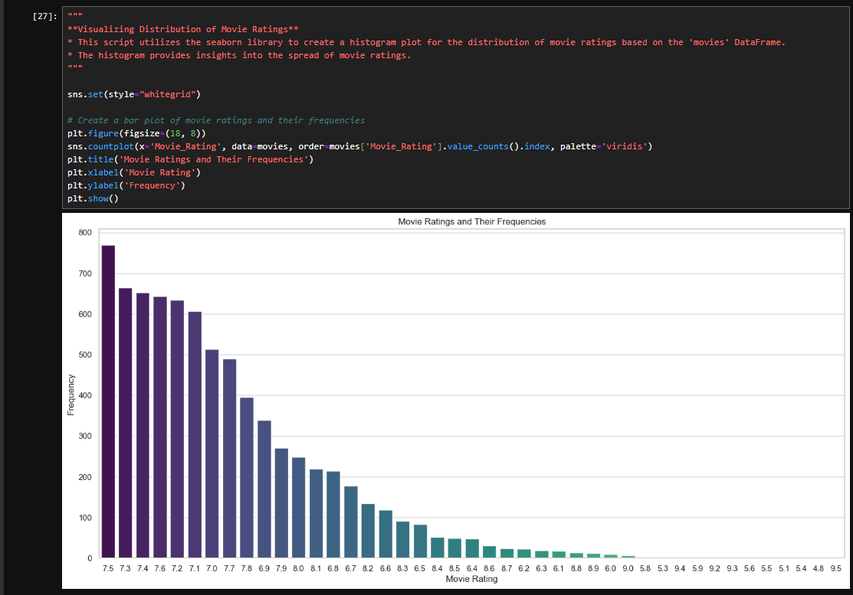
EDA Process
We Can see the visualization for Movie Ratings with its frequency.
Highest Movie Rating frequency is “7.5” and the Lowest rating frequency is “9.0”.

Slide 18
VECTORIZATION
We use Two Techniques
Count Vectorization Technique
TF-IDF Vectorization Technique
Subset data Frame containing all the Text related Columns.
Concatenate Columns and create a Tags column.
Using Count Vectorization or TF-IDF Vectorization.

Slide 19
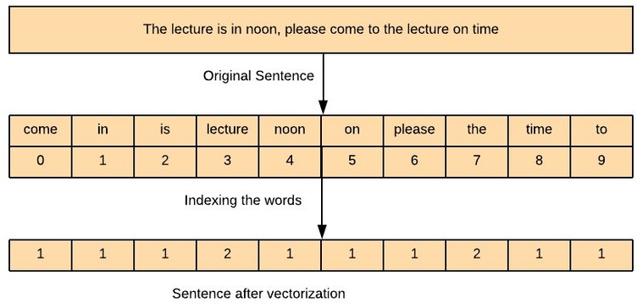
VECTORIZATION
Count Vectorization Technique

Slide 20
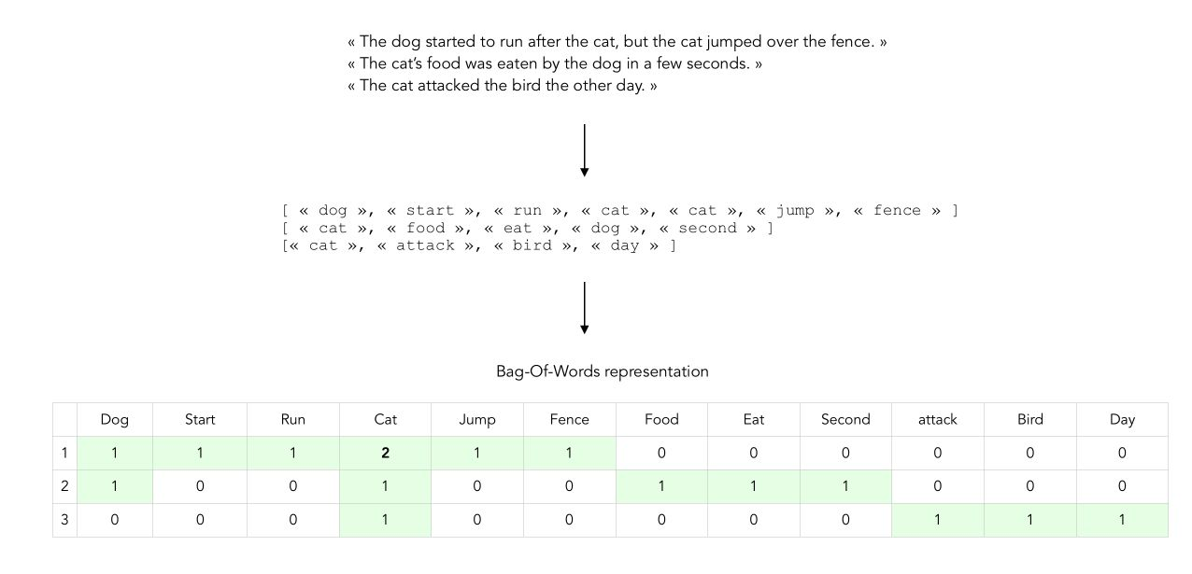
VECTORIZATION
TF-IDF Vectorization Technique

Slide 21
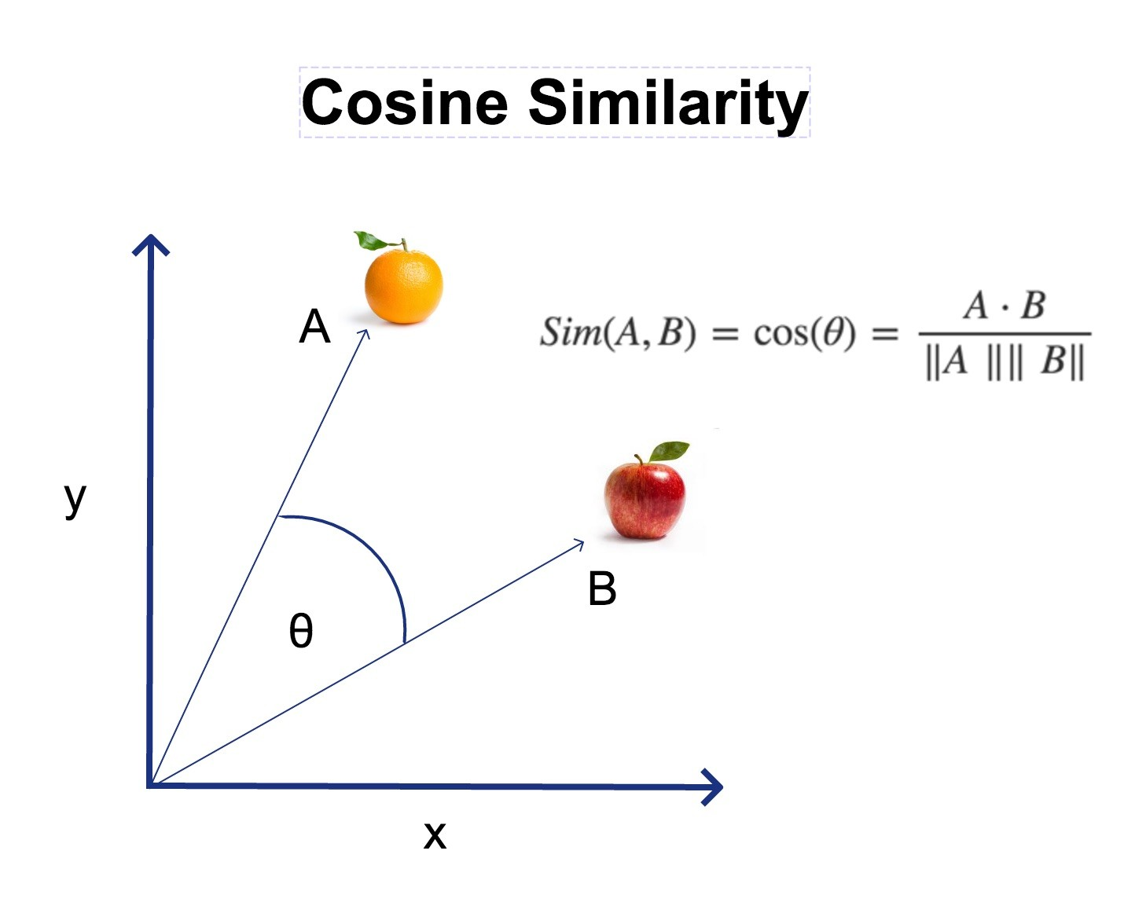
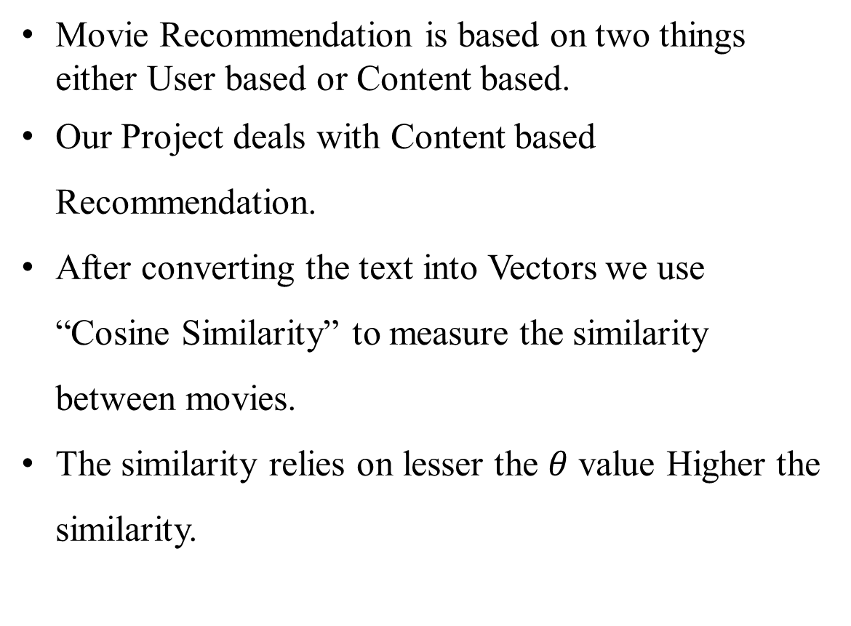
ALGORITHM
Movie Recommendation is based on two things either User based or Content based.
Our Project deals with Content based Recommendation.
After converting the text into Vectors we use “Cosine Similarity” to measure the similarity between movies.
The similarity relies on lesser the $θ$ value Higher the similarity.

Slide 22
Recommendation
System
The Recommendation System is Based on the Cosine Similarity Score between the movies.
The Recommendation system fetches Top 5 vectors similar to the given input vector.
Recommending Top 5 movies similar to the Input.

Slide 23


DEPLOYMENT
Using Streamlit for better User Interaction.
Pushed through GitHub and deployed on Streamlit app.
Link:- https://movie-recommendation-systems-nspx5uncnei2ukuwon5fdf.streamlit.app/

Slide 24
OBSTACLES
URL request was not responding.
Directors and Stars were not getting scrapped.
Missing data and its effects on results.
Using Convert to numeric every time for Calculation.
Data set Changed every time we Scrapped.
Mapping the columns with each other was difficult as we had a large amount of data.
Importing posters from the AIP and the server was not responding.
While deployment of the site the file had many errors.

Slide 25
Key Takeaway's
Always start with less amount of data.
Check if the files are loaded every time while Computation.
Plot the data using relatable plots.
Try to generate relatable insights form the data.
Keep the names of variables as simple as possible.

Slide 26
THANK YOU

